Slide 1
Section 2: Graph Pattern Matching
Computer Science and Engineering

Slide 2
Outline of Section 2
Introduction
Given a set of graphs and a pattern graph
G-Index
FG-Index (brief)
QuickSI
All-matching
TurboISO
CFL-Match
Distributed Algorithms
Similarity All-matching
Notes:
This is the outline of today’s talk. Background of our work, our approach, our two proposed advanced filters, experimental study.

Slide 3
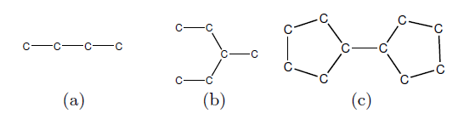
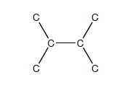
Introduction
Graph Pattern Matching is an important problem in the graph theory.
Two categories:
1. Graph Pattern Matching in Graph Database D
Given a query pattern, find all graphs in the database D containing this pattern.
Query graph
Graph Database D
Graph Database D
Notes:
Brief introduce that there are two kinds of graph pattern matching: in graph database and in a single large graph

Slide 4
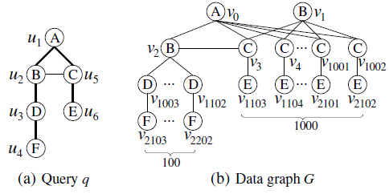
Introduction
2. All-Matching
Given a query pattern, enumerate(枚举) all subgraph embeddings of this pattern in the data graph G.
Notes:
Brief introduce that there are two kinds of graph pattern matching: in graph database and in a single large graph
And mention that we are gonna first talk about the first case in the following

Slide 5


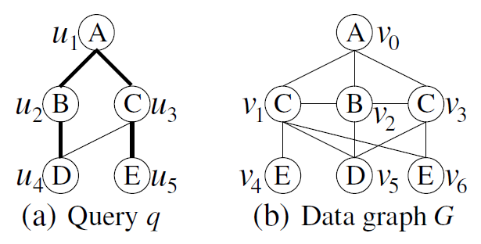
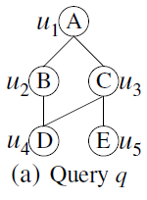


Graph Pattern Matching in Graph Database
Subgraph Isomorphism
An subgraph isomorphism is an injective function
such that
where and are the label function of and , respectively.
Notes:
Give the formal definition of the problem

Slide 6
Graph Pattern Matching in Graph Database
Naive Method
Verify all graphs in the graph database D for the given query
Infeasible: subgraph isomorphism testing is NP-complete.
Index-based methods
G-Index
FG-Index
……

Slide 7
G-Index Framework
Overview of G-Index framework
Cost Analysis
To improve the query response time, we need to minimize:
the size of graph feature set |F|
the size of candidate set C_{q}
Build offline
Query online
Graph Database D
G-Index
Query q
Search
Verification
Candidate Set C_{q}
Result
Query Response Time = T_{search} + |C_{q}| * T_{iso_test}

Slide 8
gIndex Pruning
Feature A:
ID-List: {g₁,g₂}
q
g₁
g₂
g₃
Filtering:
Pass (Feature A)
Pass (Feature A)
Pruned
Verification:
False Positive
Answer

Slide 9

Substructure Search: gIndex
Index a set F of features from D.
, D_{f} : set of graph ids in D contain f
Filtering:
Verification: verify each data graph in C_{q}.

Slide 10
G-Index Overview
Index Construction
build an inverted index on the graph feature set F
Query Processing
Search: query the index to compute the candidate set
Verification: perform subgraph isomorphism test

Slide 11
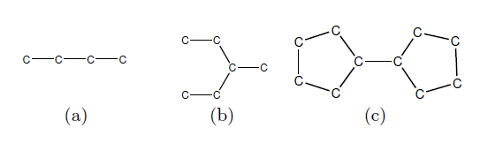
Frequent Fragment
Frequency
Given a graph database D, the frequency of g, denoted as
freq(g) = |D_{g}|
, is the number of graphs in D, which contain g as a subgraph.
For the graph “c-c”, its frequency in the database consisting of the above three graphs, is 3.

Slide 12
Frequent Fragment
Frequent graph
A graph/pattern g is frequent if its occurrence(发生) frequency is no less than a minimum frequency threshold（ 阈 ）, minFreq.
If minFreq is set to 2, then pattern “c-c”, “c-c-c” and “c-c-c-c” are frequent.
Can you locate all frequent patterns with minFreq=2 in the above given database?

Slide 13
Frequent Fragment
Uniform minFreq is infeasible
In a completely connected graph with 10 vertices, there are 45 1-edge subgraphs, 360 2-edge ones and more than 1,1814,400 8-edge ones.
It’s more appropriate to have
Low minimum frequency (threshold) on small fragments (for effectiveness)
High minimum frequency (threshold) on large fragments (for compactness)
Size-Increasing Frequency
Pattern g is frequent if and only if freq(g) ≥ f (size (g)), where freq is the occurrence frequency and f (x) is an increasing function.

Slide 14
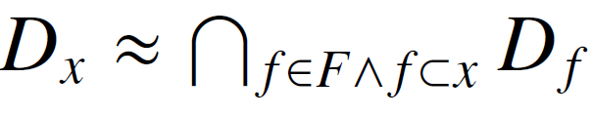
Discriminative(判别) Fragment
Do we need to index every frequent fragment?
All the graphs in the sample database contain carbon-chains: c, c-c, c-c-c, and c-c-c-c. Fragments c-c, c-c-c, and c-c-c-c do not provide more indexing power than fragment c. Thus, they are useless for indexing.
Redundant fragment
Fragment x is redundant with respect to feature set F if
c-c, c-c-c, and c-c-c-c are redundant(冗) in the above example.

Slide 15
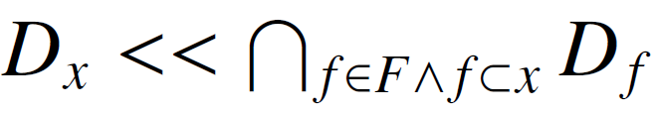
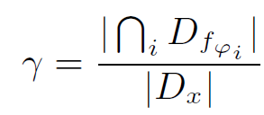


Discriminative Fragment
Discriminative fragment
Fragment x is discriminative with respect to feature set F if
In the previous example, graph (a), graph (b) and the carbon ring in graph (c) are discriminative fragments.
Discriminative ratio
where is the set of graphs containing x and
is the set of graphs which contain the proper subgraphs of x in the feature set

Slide 16





Discriminative Fragment
Use to mine discriminative fragments
Example with = 1.5
Given , its discriminative ratio is $\frac{2}{1}$ = 2 >
Thus, we add it into the feature set F.
f₁
f₂
Graph database D
Current feature set F
Both f₁ and f₂ contain the subgraphs of this pattern
Only graph(c) contains this pattern

Slide 17
G-Index Construction
Once discriminative fragments are selected, we construct G-Index using the following two steps:
Graph Sequentialization
Transfer each discriminative fragment into a sequence
Build G-Index Tree
Store all sequences of discriminative fragments into a prefix tree
Notes:
Once discriminative fragments are select, the gindex is constructed over the fragments.

Slide 18
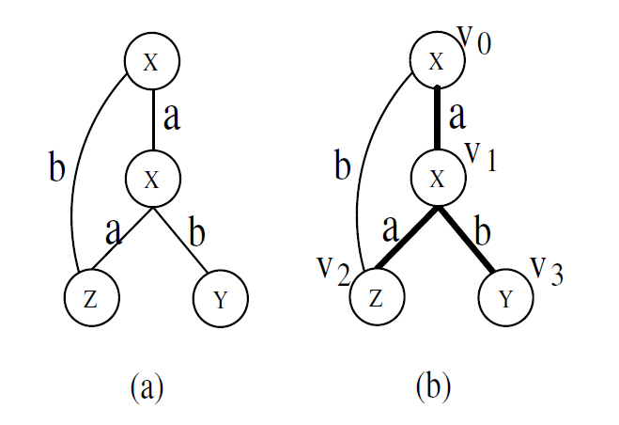
Graph Sequentialization（顺序化）
DFS Code Generation
DFS Coding translates a graph into an unique edge sequence, by performing a depth first search (DFS) in a graph.
Bold edges are the edges of DFS tree
originated from the node v₀.
The DFS Code corresponding to the DFS tree in (b) is

Slide 19



Graph Sequentialization
DFS Code Generation
Represent each edge by a 5-tuple
and and id of v_{i} and v_{j}
and are the labels of v_{i} and v_{j}
is the label of the edge connecting v_{i} and v_{j}
The previous DFS code can be represented as
Canonical（典范） label
The minimum DFS code among all of g’s DFS code, denoted by dfs(g) based on the lexicographic order.
If two fragments are the same, they must share the same canonical label.

Slide 20
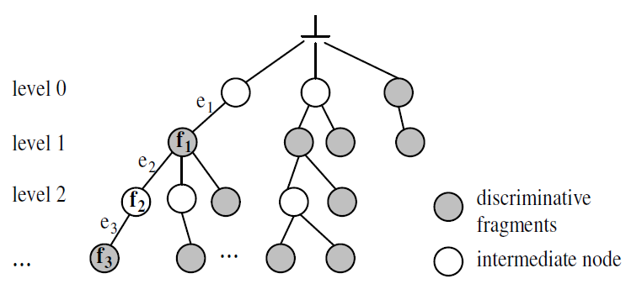
Build G-Index Tree
G-Index Tree
a prefix tree(前缀树)that store the canonical labels of discriminative fragments
Each node corresponds to a ID-list
Some redundant fragments are also stored in the G-Index Tree as intermediate nodes (white nodes).
f₁ = <e₁>
f₂ = <e_{1,} e₂>
f₃ = <e₁, e₂, e₃>

Slide 21
Query G-Index
Query q
Search with all fragments
G-Index
Insect ID-lists of
found fragments
Result
Verification
Candidate Set C
1) Enumerate all its fragments of q up to maximum size and locate them in the G-Index.
2) Intersect the ID-lists associated with found fragments to obtain candidate set C.
3) Verify the candidate set C.

Slide 22




Two Rules for Query G-Index
Apriori Pruning
If a fragment is not in the G-Index tree, we need not check its super-graphs any more.
Maximum Discriminative Fragments
If a query q has two fragments, , it is not necessary to intersect with , as
Less intersections of ID lists

Slide 23
QuickSI (VLDB2008)
An Efficient algorithm for Testing Subgraph Isomorphism
Proposed for taming verification hardness (NP-complete)
A synchronized depth-first traversal technique
Three novel pruning techniques
Notes:
QuickSI about 30 mins
Main content is QI-sequence and Swift-Index

Slide 24
Related Work
Ullmann Algorithm
First proposed subgraph isomorphism testing.
Random matching order + Backtracking

Slide 25

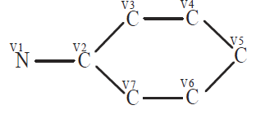
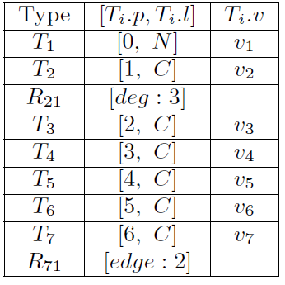
QI-Sequence
A sequence that represents a rooted spanning tree for q
Basic spanning entries, records basic information
Extra entries, records degree/back edges.
Check Degree
q
Three pruning techniques in QI-sequence :
Connected search order
Degree constraint
Extra(back) edge constraint
Check Back Edge
A possible QI-sequence for q

Slide 26
QuickSI Example
Synchronized Depth-First Traversal
3
4
1
2
5
7
6
q
Forwarding
1
2
3
4
5
Backtracking
7
6
g₁
g₂
g₃
Determine the access order in q
Detect corresponding subgraphs in g₁, g₂ which can be mapped to the currently traversed vertices.

Slide 27
QuickSI Example
Synchronized Depth-First Traversal
3
4
1
2
5
7
6
q
Forwarding
1
2
3
4
7
Backtracking
5
6
g₁
g₂
g₃
Determine the access order of q
Detect corresponding subgraphs in g₁, g₂ which can be mapped to the currently traversed vertices.

Slide 28
QuickSI Example
Synchronized Depth-First Traversal
3
4
1
2
5
7
6
q
Forwarding
3
4
1
2
5
7
6
g₁
g₂
g₃
Determine the access order of q
Detect corresponding subgraphs in g₁, g₂ which can be mapped to the currently traversed vertices.

Slide 29
QuickSI Example
Access infrequent labels
as early as possible
Synchronized Depth-First Traversal
1
1
q
1
1
1
1
1
1
1
1
1
g₁
g₂
g₃
Determine the access order for q.
Detect corresponding subgraphs in g₁, g₂ which can match the currently traversed vertices.

Slide 30
QuickSI Example
Access infrequent labels
as early as possible
Synchronized Depth-First Traversal
2
Retain connectivity
1
Sparse Graph!
2x5=10 possible matching pairs
q
1
2
2
1
2
2
2
g₁
g₂
g₃
Determine the access order for q.
Detecting corresponding subgraphs in g₁, g₂ which can match the currently traversed vertices.

Slide 31
QuickSI Example
Access infrequent labels
as early as possible
Synchronized Depth-First Traversal
Deg=3
3
4
Retain connectivity
1
2
2
5
7
6
Effectively use degree information
q
Stop here
Deg=2
1
2
2
3
4
5
7
6
g₁
g₂
g₃
Determine the access order for q.
Detecting corresponding subgraphs in g₁, g₂ which can match the currently traversed vertices.

Slide 32
QuickSI Example
Access infrequent labels
as early as possible
Synchronized Depth
First Traversal
Deg=3
3
4
Retain connectivity
1
2
5
7
6
Effectively use degree information
q
Stop here
Deg=2
1
2
3
4
1
2
5
7
6
g₁
g₂
g₃
Continue
Deg=3
Determine the access order for q.
Detecting corresponding subgraphs in g₁, g₂ which can match the currently traversed vertices.

Slide 33
Swift Index
A New Filter Approach
Precompute QI-Sequence for all indexed features(fragments)
Only tree features are indexed for lower cost of feature mining
Index all QI-Sequences in a prefix tree, called Swift Index
Given three graphs in D
g₁
g₂
g₃
Mined Features and their ID-List:
ID-List: {g₃}
ID-List: {g₁,g₂,g₃}
ID-List: {g₂}
ID-List: {g₁,g₂}

Slide 34
Swift Index
The constructed Swift Index is
Prefix Tree
Deg=3
Features:
ID-List: {g₃}
ID-List: {g₁,g₂,g₃}
ID-List: {g₂}
ID-List: {g₁,g₂}

Slide 35
Query Swift Index
Given a query q, traverse the prefix tree from the top to the bottom in the depth-first fashion, to obtain candidate set.
3
1
2
q
Prefix Tree
1
Deg=3
2
Features:
3
3
ID-List: {g₃}
ID-List: {g₁,g₂,g₃}
ID-List: {g₂}
ID-List: {g₁,g₂}
Candidate set for q is {g₁,g₂,g₃}

Slide 36

Thank you!
Questions?

